Slide 1
Overview and Demo of CaIntegrator2
A Tool for Publishing and Analyzing Integrated Study Data
William FitzHugh
Eric Tavela
September 23, 2008

Slide 2
Goals
Have a single place where one can go to get all the information about a study
Clinical Data
Imaging Data
Genomic Data
Provide ways to browse and analyze the data
Explore and confirm hypotheses
Publish results and lists, e.g. of interesting genes
Have a way to roll out new studies easily
Have a consistent user experience across different studies
Lay the groundwork for cross-study comparisons

Slide 3


caIntegrator Examples
Rembrandt
A brain tumor study to host and integrate clinical and functional genomics data from clinical trials involving patients suffering from gliomas
CGEMS
A project to identify genetic alterations that make people susceptible to prostate and breast cancer
Others
I-SPY
caGWAS

Slide 4
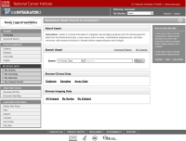
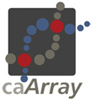

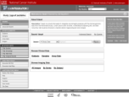





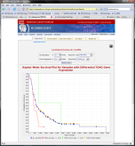
How caIntegrator2 works
Software Development Team
Project Team
Public
View Study
Array Data
caIntegrator2
Project Team
TBD (CTODS)
Deploy Study
Study Manager
Clinical Data
Images
Image Annotations
TBD (AIM/NCIA)
caIntegrator2
Tissue Data
caIntegrator
Array Data
Project Team
Public
Software Development Team
Project Team
Clinical Data
Rembrandt (for example)
Imaging Data
Process repeated for each project, reusing code and developer expertise

Slide 5
What caIntegrator2 can do
Browse and filter lists of major entities
Subjects
Samples
Write complex queries
Join across clinical, microarray and image data
Publish queries to other users that return lists of interesting genes, subjects and/or images
Do analysis
Kaplan-Meier Survival Curves
Export to GenePattern or GEWorkbench

Slide 6
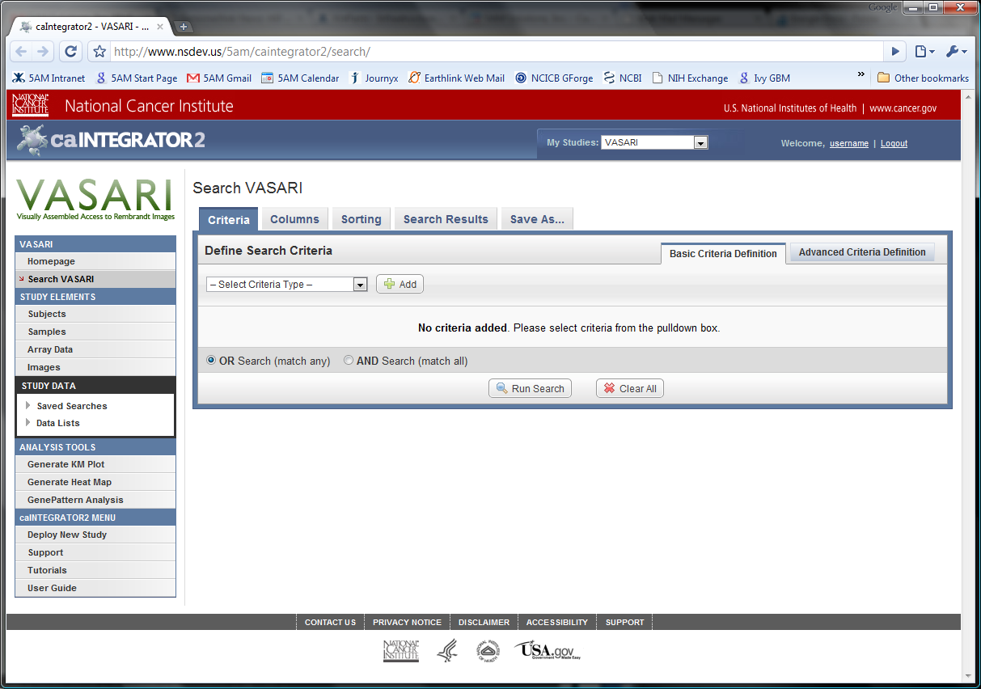

Slide 7
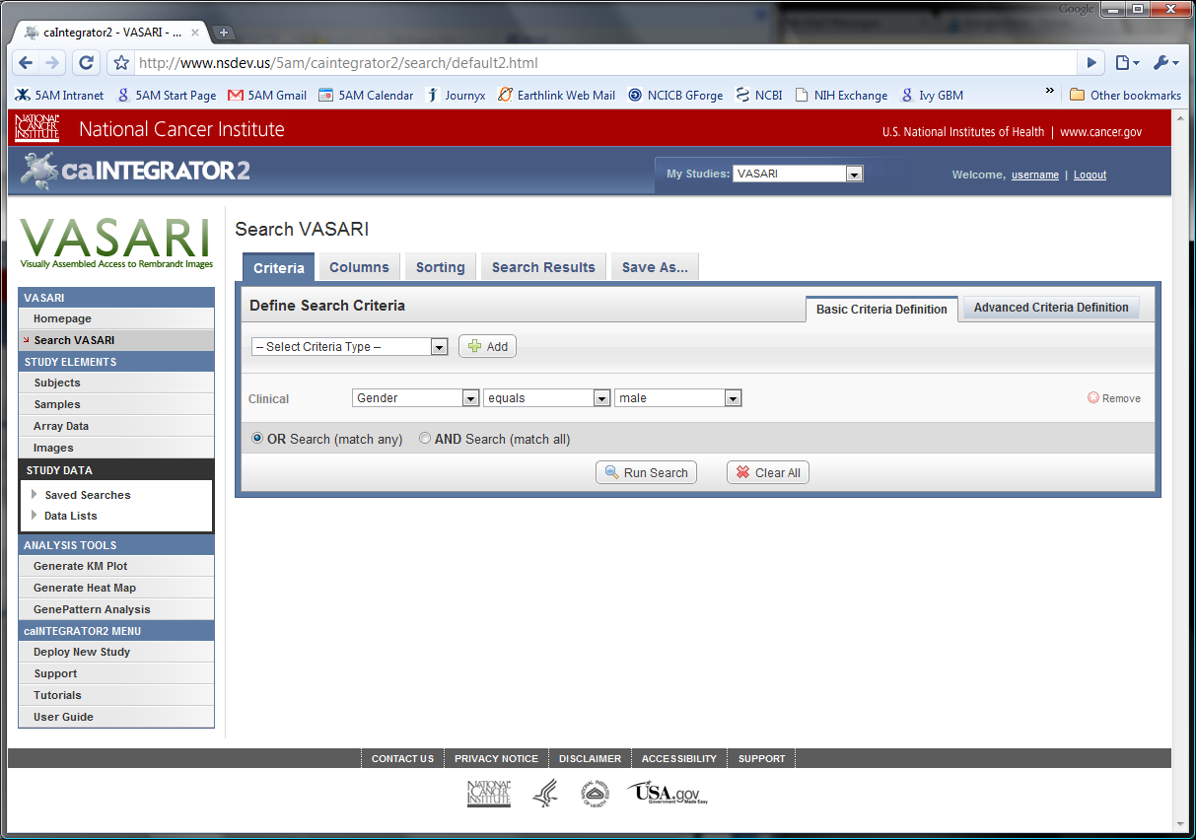

Slide 8
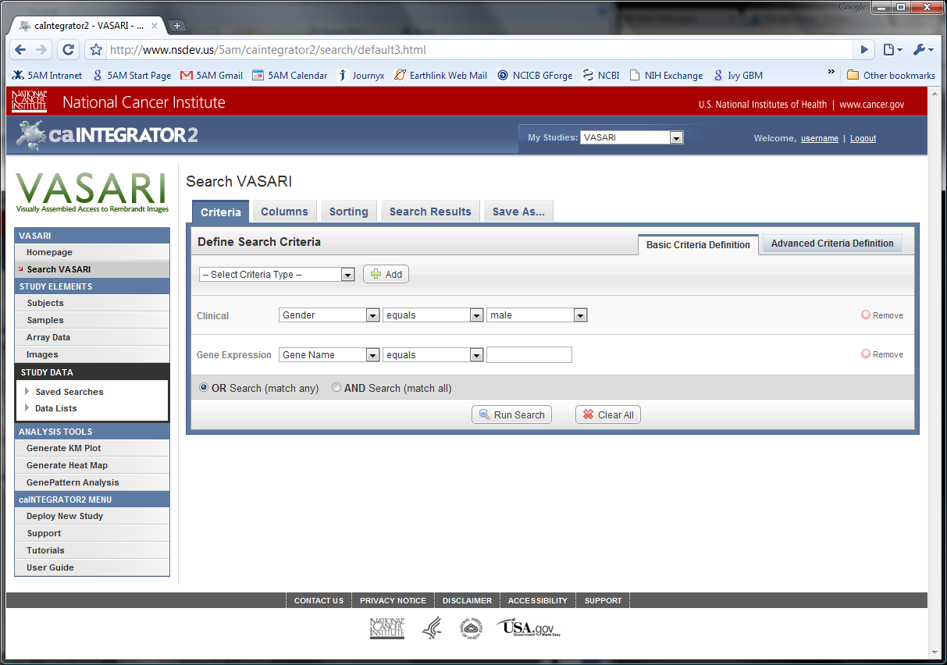

Slide 9
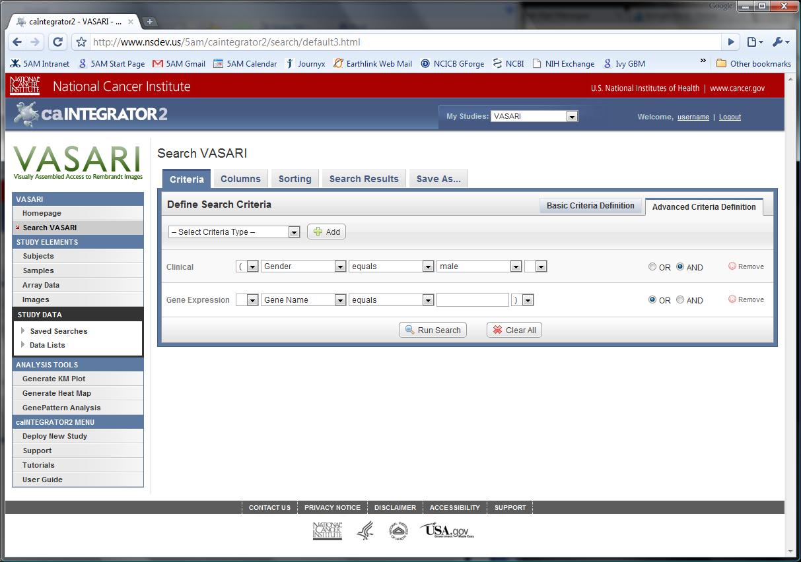

Slide 10
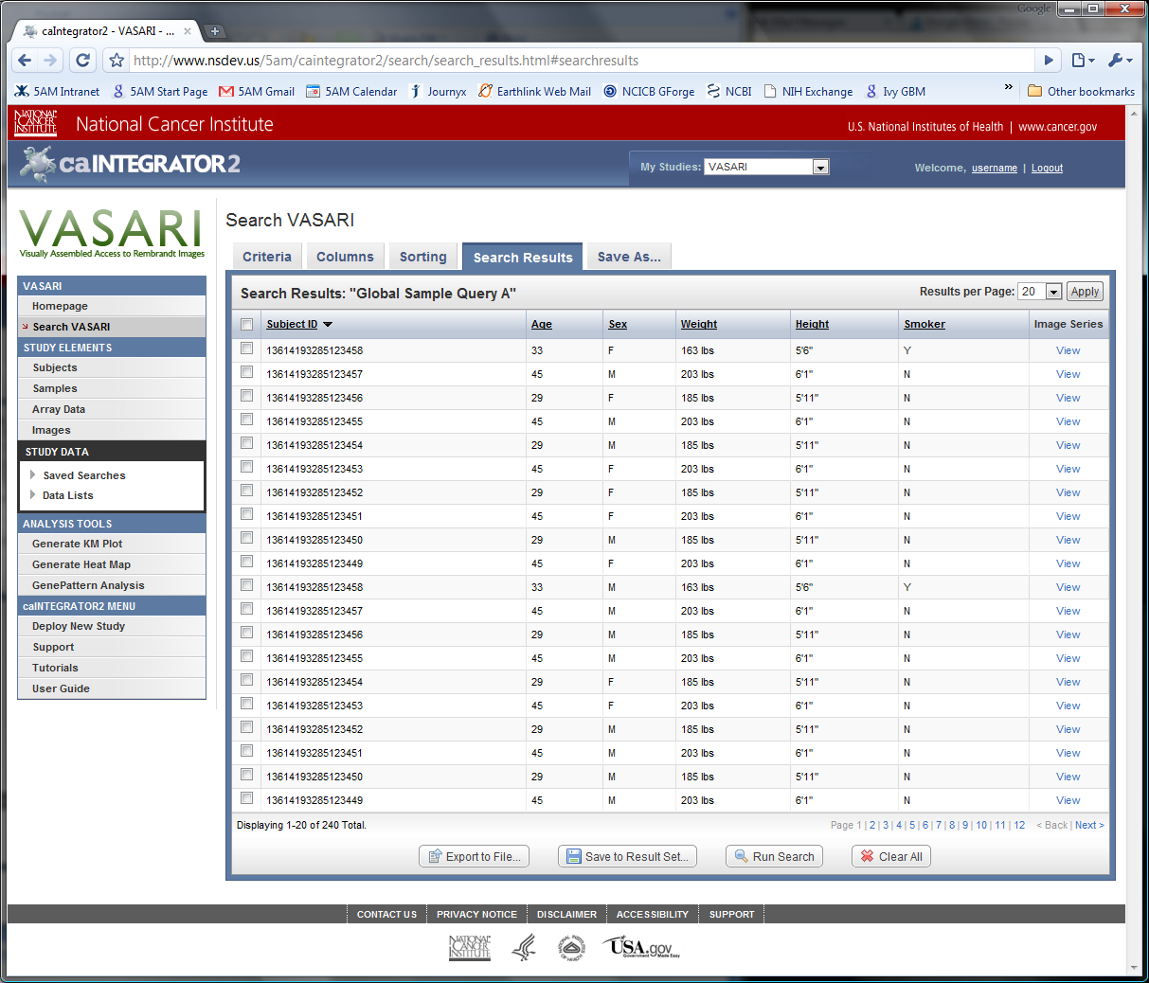

Slide 11
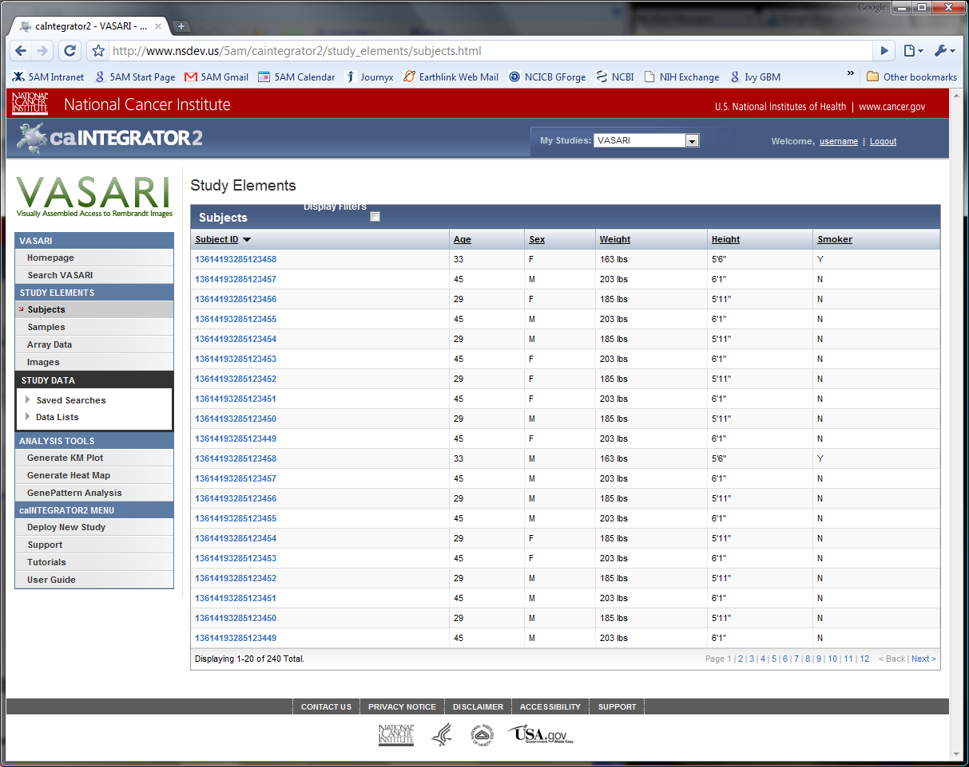

Slide 12
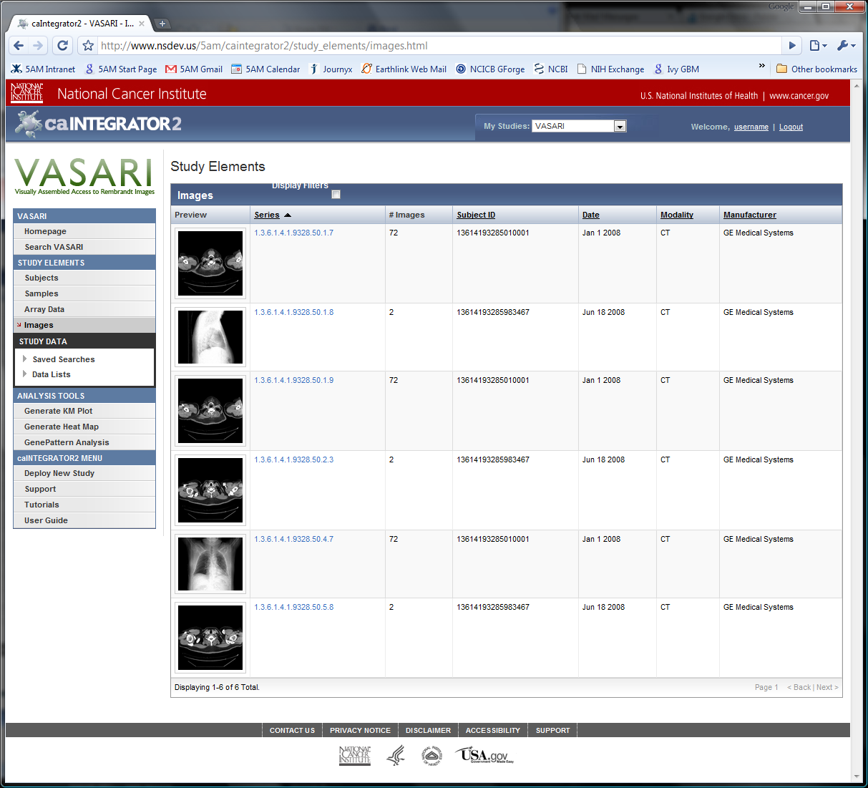

Slide 13


What’s next
Future Directions
Looking for interested partners running these kinds of studies
Opportunity to guide future development
Incorporate other types of genomic data such as copy number, methylation, tissue microarray, and genotypes
Tighter integration with GenePattern and other analysis tools
Handle studies with multiple timepoints
Allow regular updates of data
geWorkbench
Diagnosis Treatment Followup

Slide 14
Credits
caIntegrator2 Team
TJ Andrews
William FitzHugh
Michael Holck
Shine Jacob
Mark Lewis
JP Marple
Sangeetha Rajagopal
Matt Rehfuss
Eric Tavela
Leadership and Vision
Anand Basu
Subhashree Madhavan
NCIA & VASARI
Adam Flanders
John Freymann
Carl Jaffe
Daniel Rubin
caIntegrator Development Teams

